Slide 1

EEE 4800
Optimization of Hybrid Renewable Energy System (HRES) for a Remote Area in Bangladesh
by
Sk Asad Al Abir (200021331)
Pushpita Khan (200021354)
K.M. Sirazul Monir (200021247)
Supervisor: Hasan Jamil Apon

Slide 2

Table of Contents
Introduction
1
Current Scenario
Accessibility Issues in Remote Areas
Problem Statement
Proposed Solution
Background and Motivation
HOA
Literature Review
HOA Overview
System Overview
Results
Complex Engineering Aspects
Social, Environmental & Ethical Impact
References
3
5-6
7
8
9
11
12
13-16
17-23
24-34
35-38
39-41
43

Slide 3
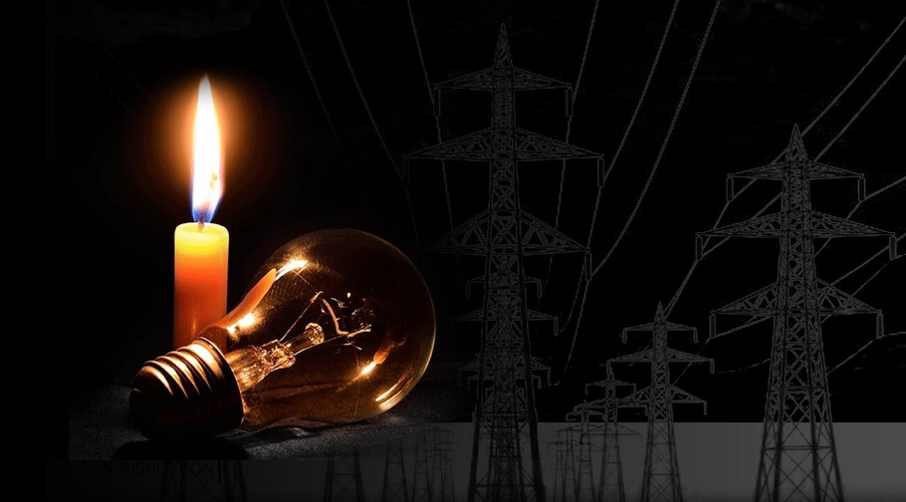
Introduction
Context
Rapid increase in electricity demand.
Limited access of the remote areas to national grid.
Problems
Heavy dependance on fossil fuel.
Low renewable adoption
Motivation
Developing a cost-efficient, sustainable and reliable project.
A Hybrid Renewable Energy System (HRES) incorporating solar, wind, biomass and battery storage.
1

Slide 4
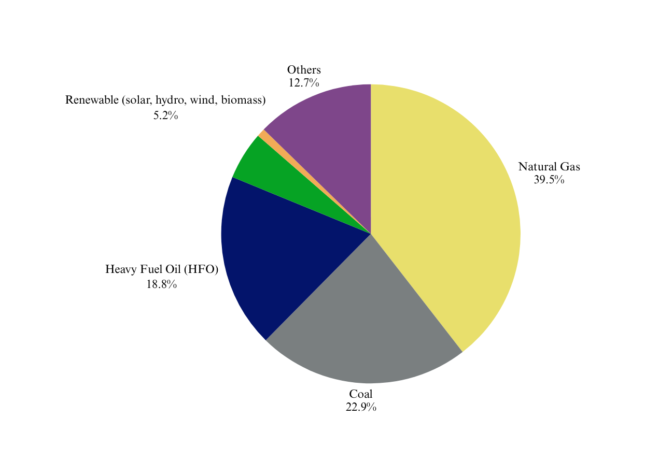
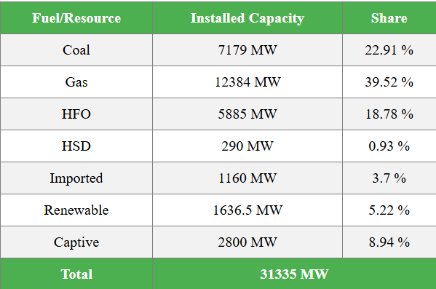
Energy Sources
Source: SREDA
2

Slide 5

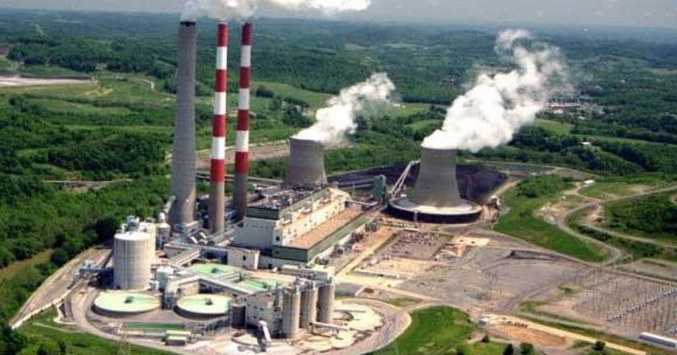
Current Scenario
Total power generation capacity 28,166 MW (approx).
Peak demand 17,200 MW.
Annual energy demand is rising by 10–12%.
Bangladesh targets 34,000 MW capacity by 2030.
3

Slide 6

Challenges & Risks
Nationwide
Remote Area
Grid failures despite surplus capacity.
Heavy reliance on fossil fuels.
Import dependance.
Limited grid access.
High Dependance on Kerosene and Diesel.
Energy poverty.
4

Slide 7
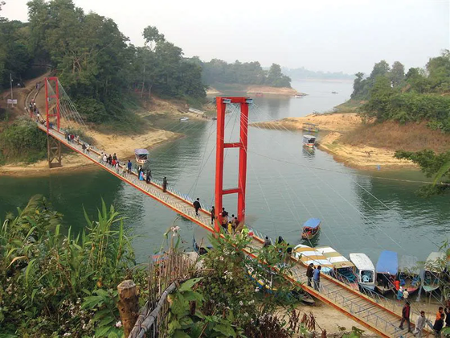
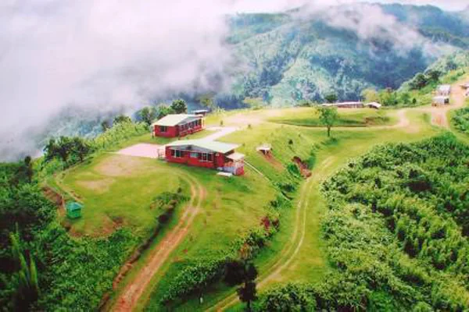

Accessibility Issues in Remote Areas
Chittagong Hill Tracts (CHT)
Rangamati
Khagrachhari
Bandorban
Population: ~0.8 million
Electricity Access: 60-70%
Underserved Areas: Remote hilly regions
Population: ~1.2 million
Electricity Access: 85%
Underserved Areas: Remote hilly areas
Population: ~0.4 million
Electricity Access: 50-60%
Underserved Areas: Mountainous regions
5

Slide 8
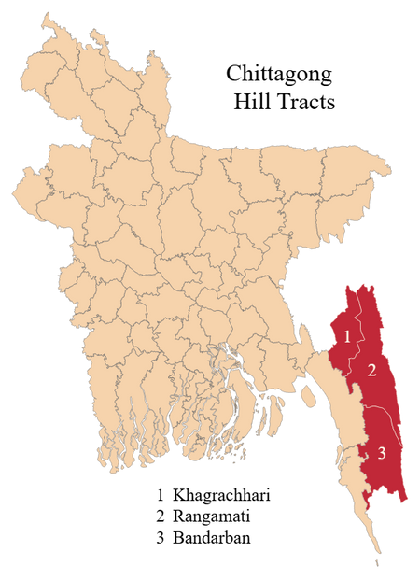

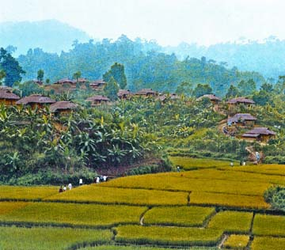
Accessibility Issues in Remote Areas
13,295 square kilometers
10% of Bangladesh’s total land area
1.6 million people
More than 10 indigenous ethnic groups
More than 30% of villages in the region are accessible only by foot or waterways
6

Slide 9

Problem Statement
1.6M+ people live in CHT; many lack reliable electricity
30%+ villages not connected to the grid (hilly terrain, cost)
Diesel generators are costly, polluting, and unreliable
National electrification ≠ actual rural access in CHT
7

Slide 10
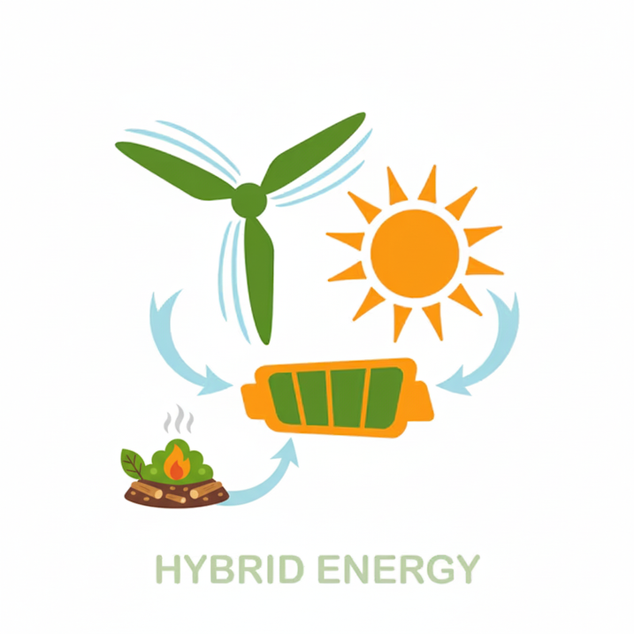

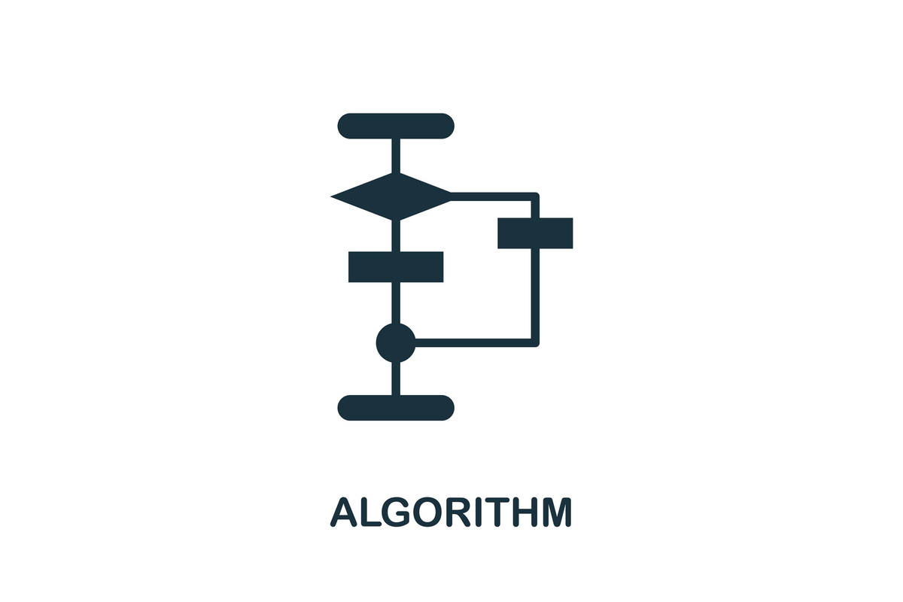

Proposed Solution
Hippopotamus Optimization Algorithm
Smarter sizing of components
Efficient use of local energy resources
Minimization of cost and energy losses
Hybrid Renewable Energy System,
optimized with
Hippopotamus Algorithm
8

Slide 11




Background & Motivation
A Hybrid Renewable Energy System (HRES) can provide:
Continuous and clean power
Cost savings over diesel-based systems
Environmental benefits (reduced CO₂ emissions)
4–6.5 kWh/m²/day
Wind: >4 m/s
Abundant rice husk
9

Slide 12

Goals and Objectives
Assess feasibility in remote areas
Model PV, wind, biomass, battery systems
Use HOA for optimal sizing
Minimize cost, ensure reliability
Analyze social & environmental impact
Design & optimize cost-effective HRES
Primary Objective
Secondary Objective
10

Slide 13
Hippopotamus Optimization Algorithm
Load Demand
Hippopotamus
Algorithm
Optimal Sizes of PV, Wind, Biomass & Battery
Minimize Cost & Ensure Reliable Power Supply
Component Costs
11

Slide 14
Literature Review
Title: Present scenario of renewable energy in Bangladesh and a proposed hybrid system to minimize power crisis in remote areas
Title: Hippopotamus optimization
algorithm: a novel nature‑inspired
optimization algorithm
Chowdhury et al. (2012): Proposed hybrid PV-wind-biogas system for rural areas
Amiri et al. (2024): Introduced Hippopotamus Optimization Algorithm for engineering design
[1]
[2]
Title: Current Status of Renewable Energy Sector in Bangladesh and a Proposed Grid Connected Hybrid Renewable Energy System
Title: Energy scarcity and potential of renewable energy in Bangladesh
Ullah et al. (2012): Grid-connected hybrid system model for energy resilience
Halder et al. (2015): Quantified biomass-to-electricity potential of 373 TWh/year
[3]
[4]
12

Slide 15
System Optimization Strategy
Phase-1
Phase-2
Phase-3
Position Updating in Rivers/Ponds (Exploration Phase):
Hippos move within their territory to explore the solution space.
The best-performing hippo leads the movement.
Distinct models for male, female, and immature hippos ensure diverse exploration.
Defensive Strategies Against Predators (Exploration Phase):
Hippos coordinate defensive actions to escape poor solutions.
Helps avoid local optima and enhances exploration.
Evasion Methods (Exploitation Phase):
Hippos make quick, localized movements to exploit optimal solutions.
Focuses on refining and improving the best-found positions.
1
13

Slide 16
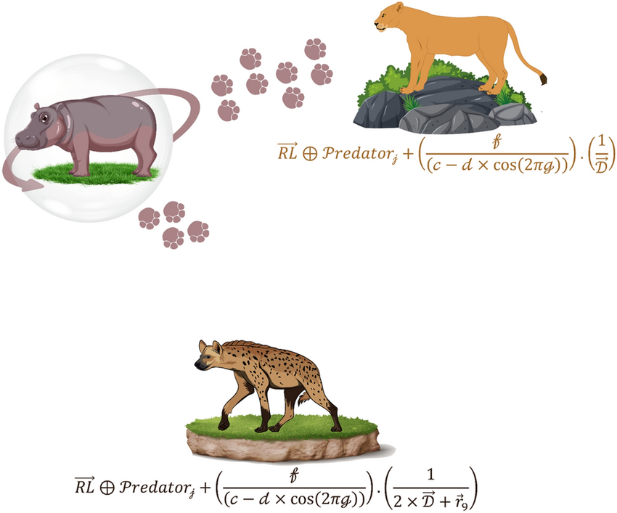
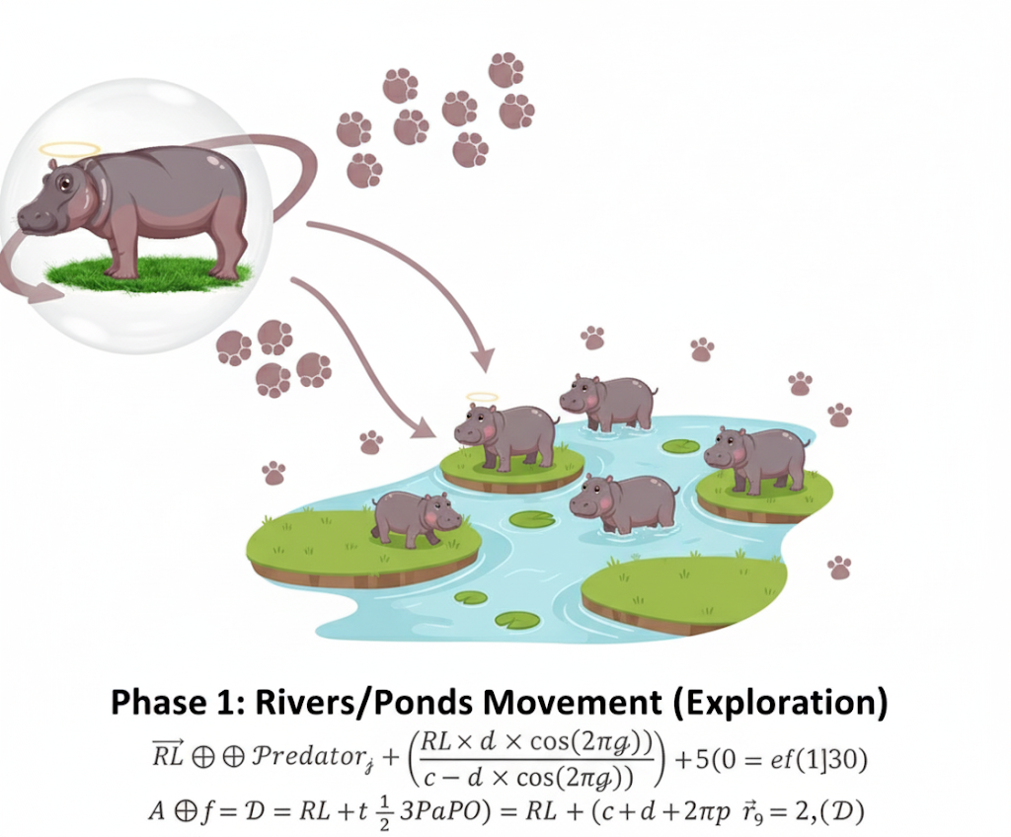
Visual Representation
Phase 2: Defensive Strategies Against Predators (Exploration)
14

Slide 17
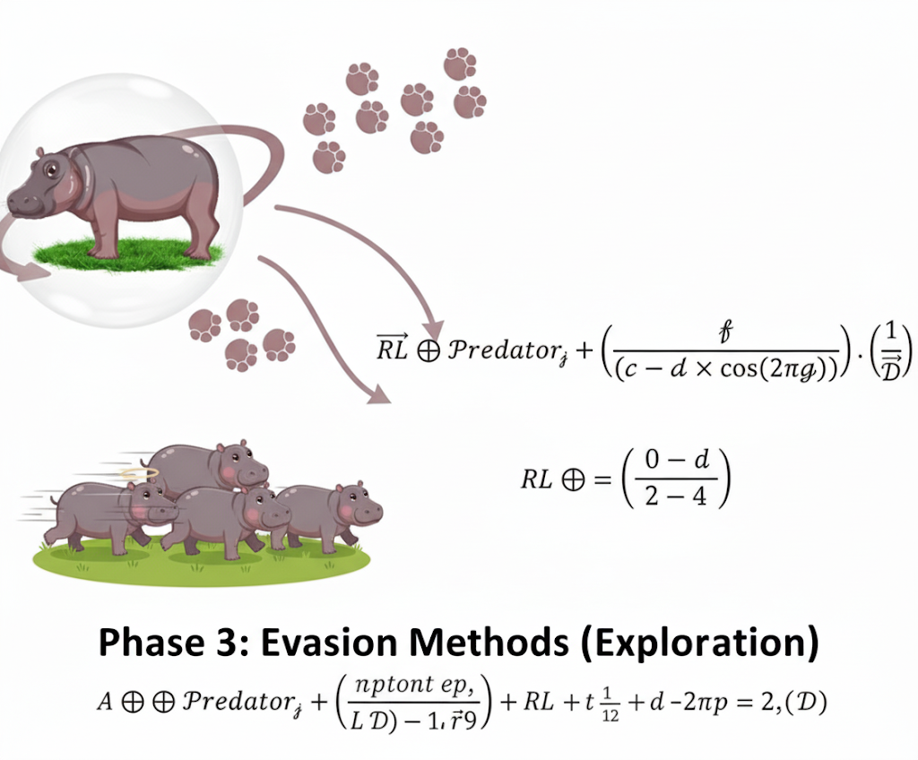
Visual Representation (Cont.)
Phase 3: Evasion Method (Exploitation)
15

Slide 18



Performance and Application
Goal
Strengths
Modifications
Find the optimal solution by improving candidate solutions (hippopotamus population).
Similar to PSO and GWO.
Balances exploration and exploitation effectively.
Outperforms other algorithms in performance and stability.
Variants like MHO and IHO enhance performance.
Incorporate chaotic maps and adaptive mechanisms.
16

Slide 19
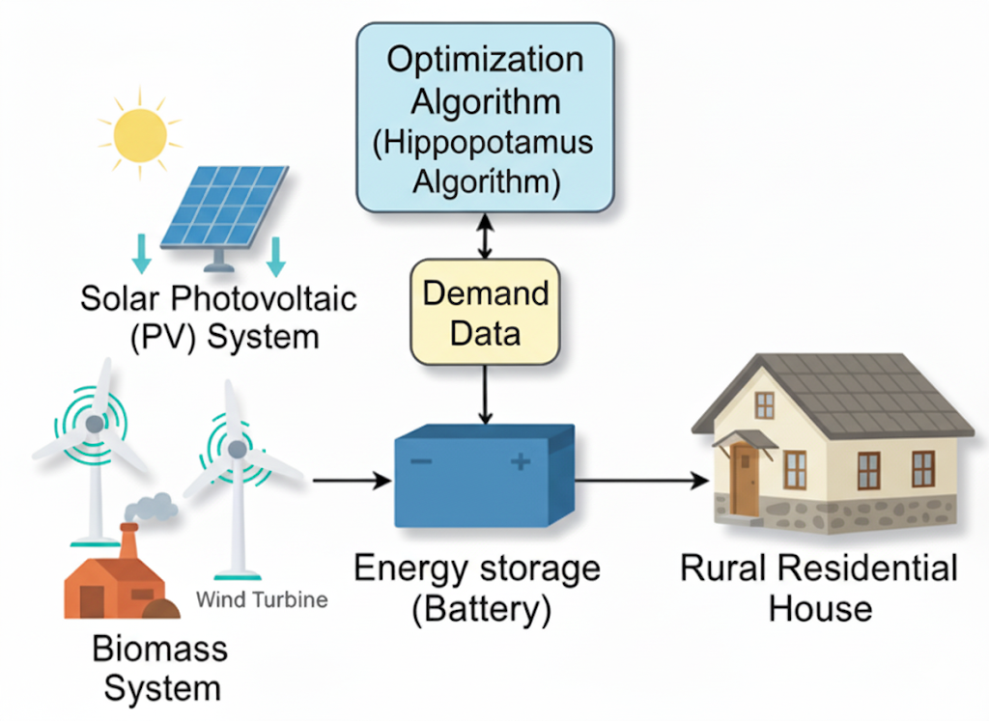
System Overview Diagram
17

Slide 20



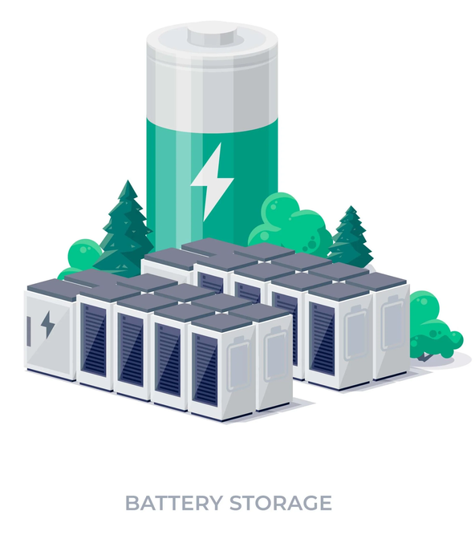
Proposed HRES Components
Solar PV Cell
Biomass
Windmill
Battery Storage
18

Slide 21
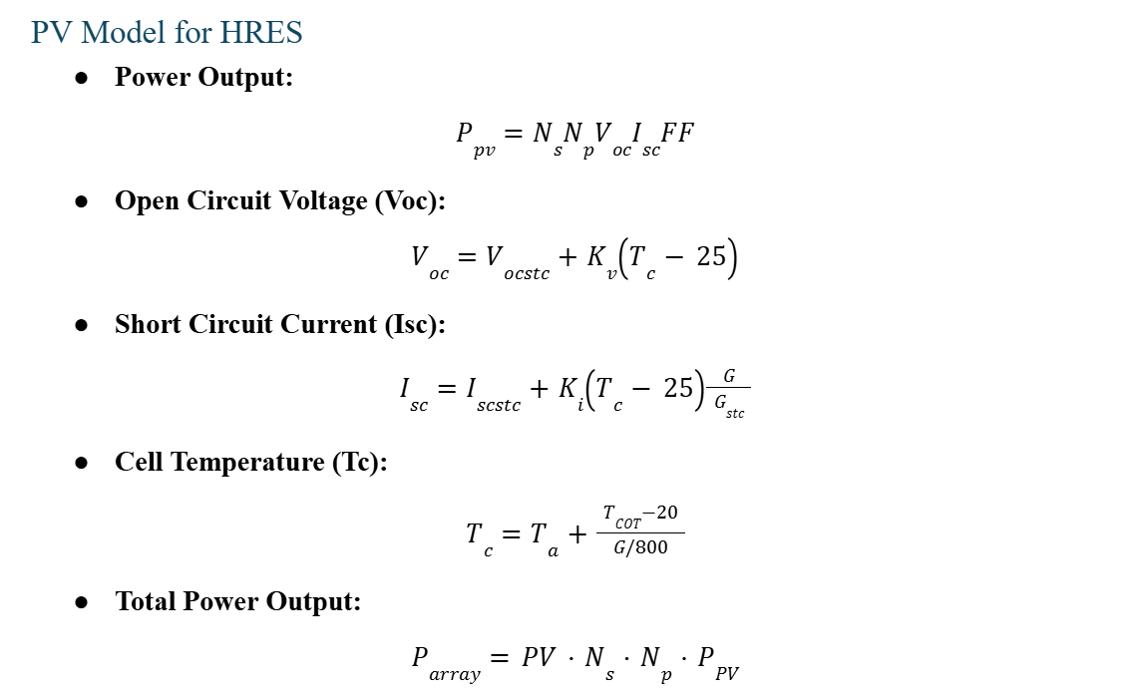
Mathematical Modeling (PV System)
Where,
Voc =Open Circuit Voltage
Isc = Short Circuit Current
Ns= Number of PV modules in series
Np= Number of PV module in parallel
NCOT=Nominal Cell Operating Temperature
G_Stc= Solar Irradiance at Standard Test Condition
FF= Fill Factor
Kv=Open Circuit Voltage Temperature Coefficient
Ki= Short Circuit Current Temperature Coefficient
19

Slide 22
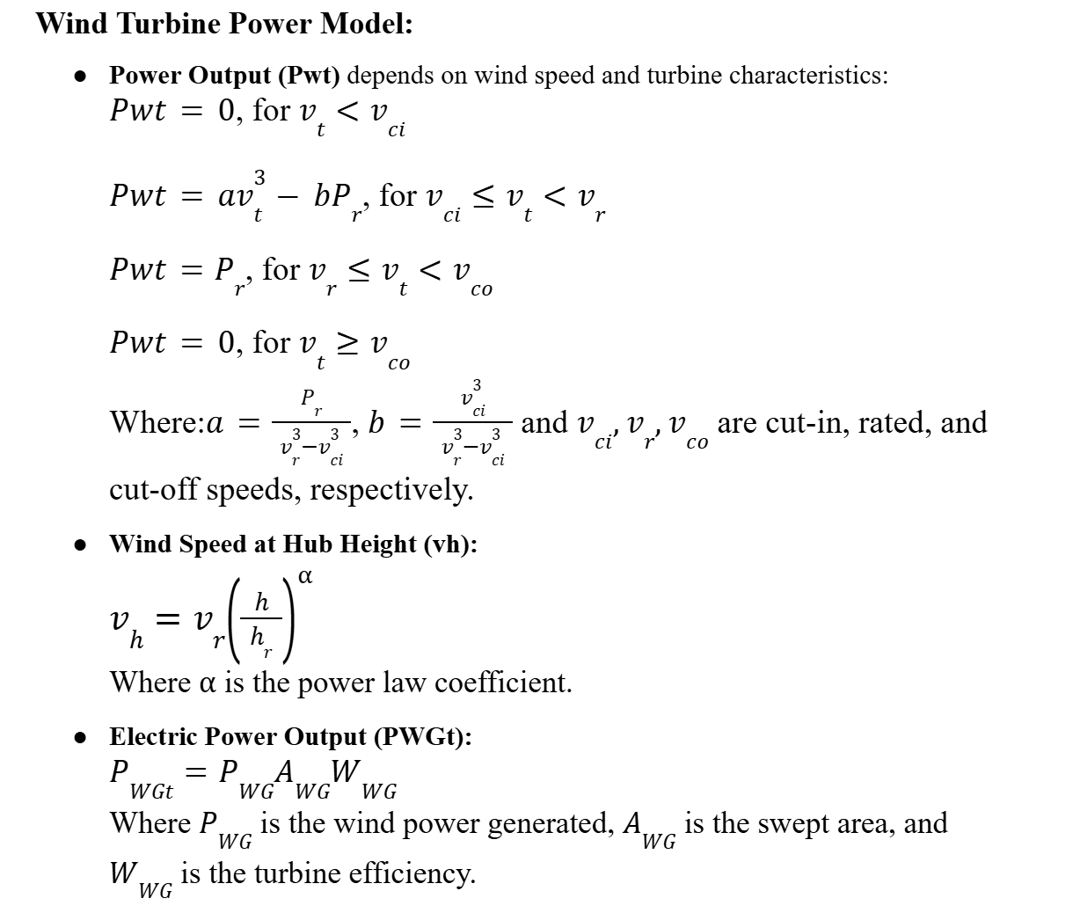
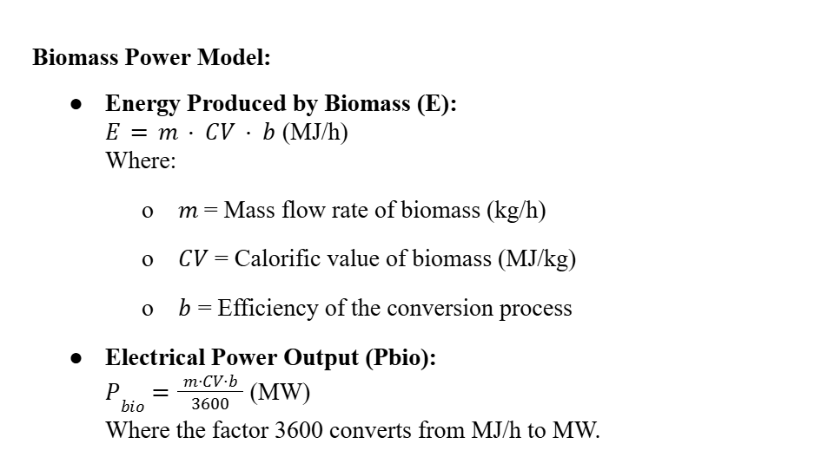
Mathematical Modeling (Wind & Biomass)
20

Slide 23
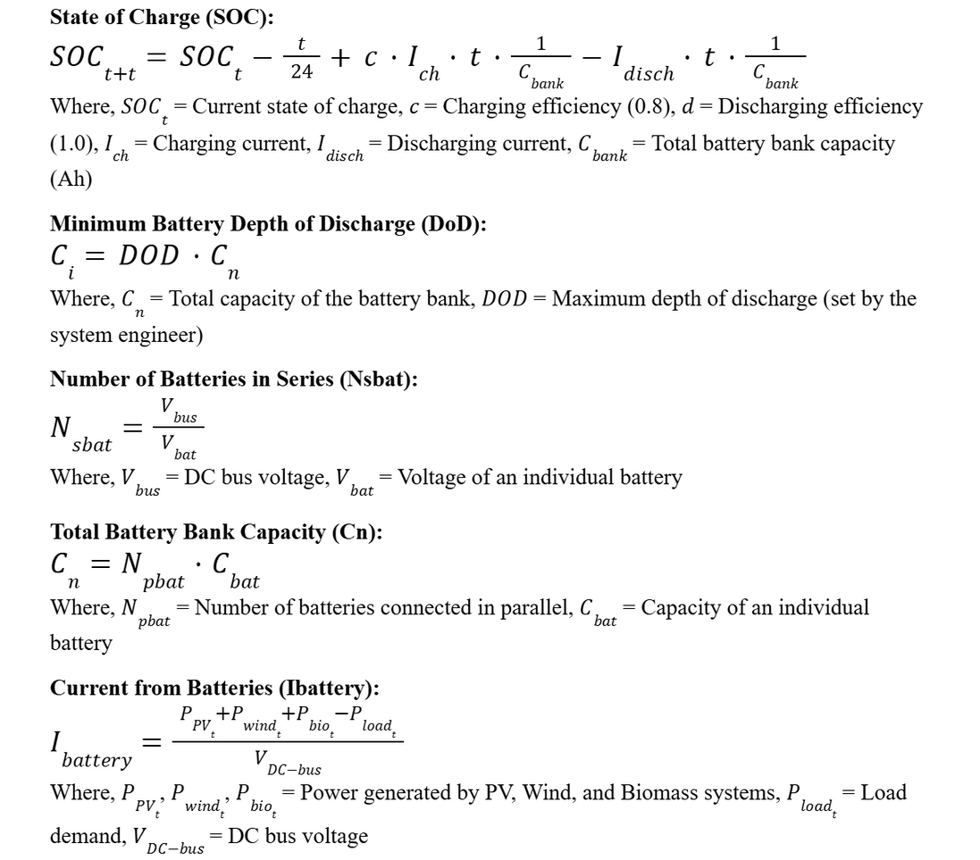
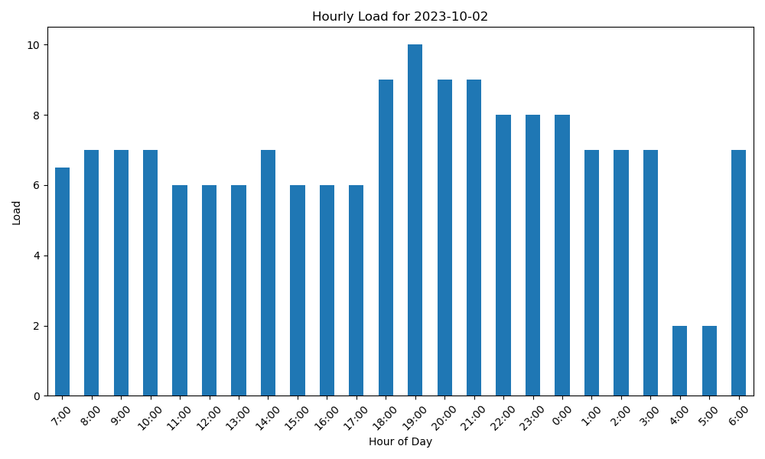
Battery Storage & Load Profile
Fig: Hourly Load Profile
21

Slide 24


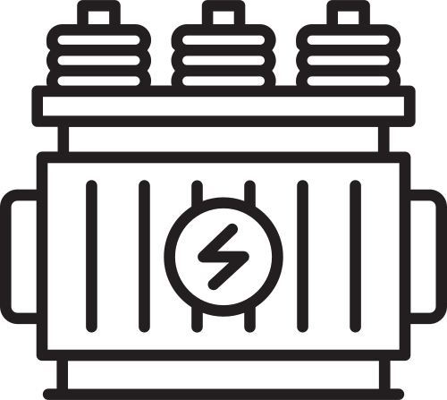
Data Collection Sources
Solar Irradiance (W/m²)
Collected from PVGIS
Used to estimate daily solar power generation
Wind Speed (m/s)
Also sourced from PVGIS
Used to calculate wind turbine power output
Ambient Temperature (°C)
Required for computing PV parameters like
Open Circuit Voltage (Voc) and Short Circuit Current (Isc)
Load Demand (kWh/day)
Provided by Dohazari 132/33 KV Grid substation
Reflects actual energy consumption needs
22

Slide 25
Simulation Steps
1.
Start/Parameter Setup
Input Battery Parameters
Input biomass, PV, Wind & Cost Parameter
Load Solar, Wind & Load Profile Data
Calculate Biomass Energy & Power Output
Compute Total Generation (Hourly)
2.
Calculate PV Power Output
Calculate Wind Power Output
Compare Generation with Load Demand
If Generation ≥ Load → Supply Load
Charge Battery (if not full), else Dump Excess Power
If Generation < Load → Discharge Battery (if not empty)
3.
Update Battery State of Charge (SOC) & Apply Self-Discharge
If Battery Empty → Record Power Shortage
Perform Cost Calculations (Battery, PV, Wind, Biomass, System Total)
Display Results (Performance + Cost Analysis)
4.
23

Slide 26
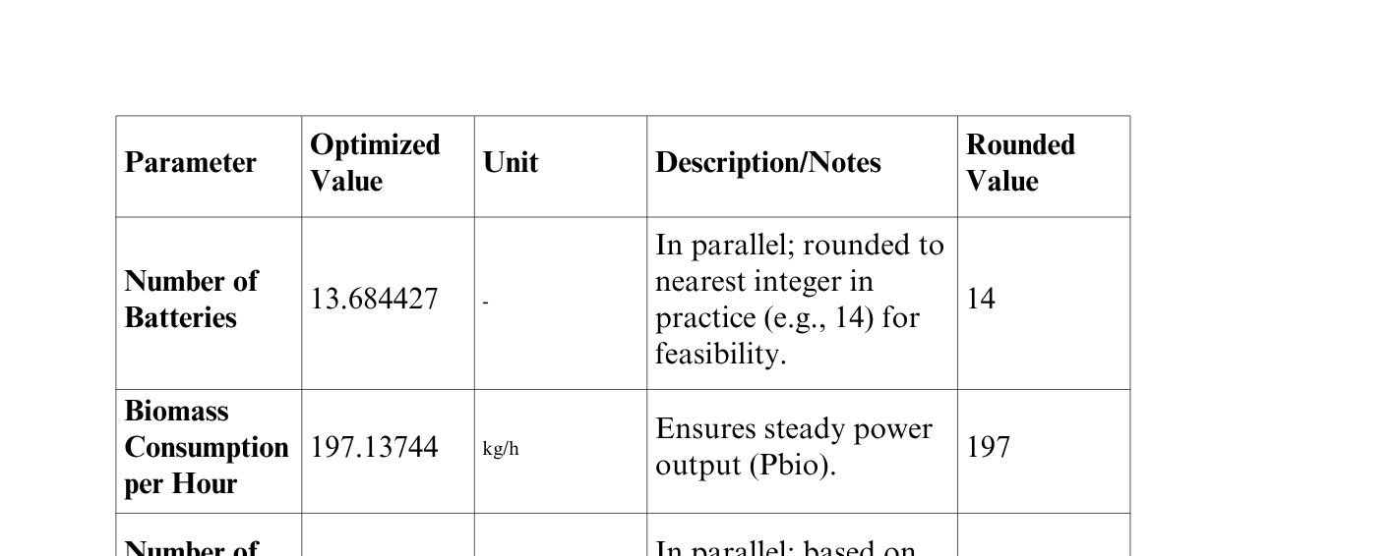
Results
Output of the Optimization Algorithm
24

Slide 27
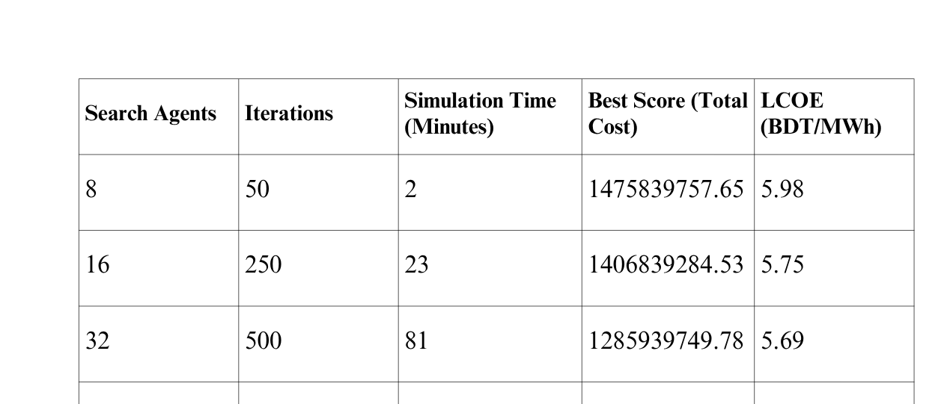
Results
Effect of Search Agents on Cost Optimization
25

Slide 28
Results
Effect of Search Agents on Cost Optimization
Increasing search agents and iterations lead to longer simulation times.
Total cost decreases with more search agents and iterations, indicating improved optimization.
LCOE (Levelized Cost of Energy) decreases from 5.98 BDT/MWh (8 agents) to 5.63 BDT/MWh (64 agents), showing better cost efficiency.
26

Slide 29
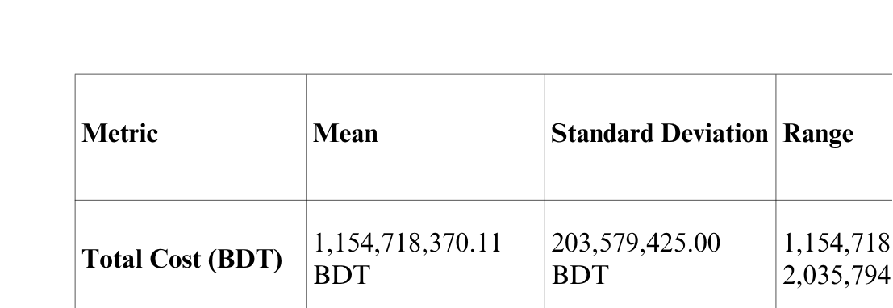
Results
Statistical Analysis
27

Slide 30
Results
Statistical Analysis
Total Cost: Mean of 1.15 billion BDT, with a standard deviation of 203.58 million BDT, indicating fluctuation due to stochastic factors. Range: 1.15 billion to 2.04 billion BDT.
LCOE: Mean of 5.78 BDT/MWh, with a small standard deviation (0.12 BDT/MWh), indicating minimal variation. Range: 5.63 to 6.02 BDT/MWh.
This shows stable LCOE with some variability in total cost due to uncertainties like weather and demand.
28

Slide 31
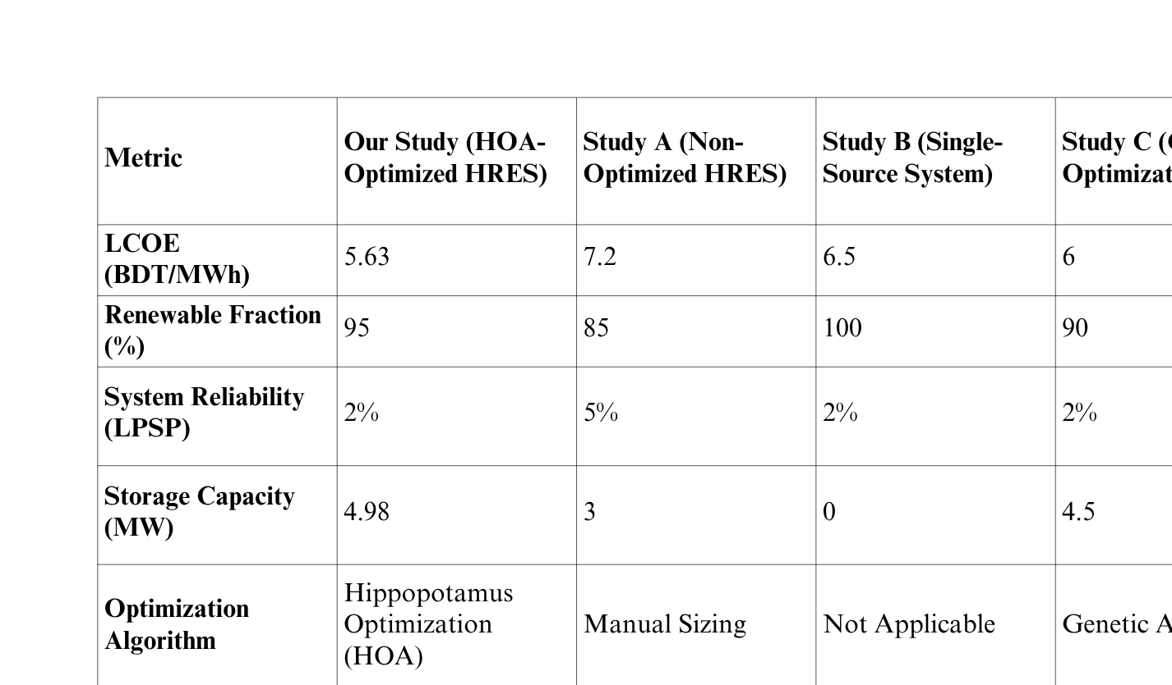
Results
Comparative Analysis
29

Slide 32
Results
Comparative Analysis
Our Hybrid System: LCOE of 5.63 BDT/MWh, optimized with large-scale solar, wind, biomass, and battery storage for cost efficiency.
St. Martin’s Island (Kyushu University, 2021): LCOE of 15.54 BDT/MWh, higher due to smaller scale and resource limitations.
Pabna Hybrid System (Md. Samiul Islam et al., 2022): Likely higher LCOE, due to smaller scale and lack of large storage.
Kuakata Off-Grid (Wiley, 2021): Higher LCOE, off-grid nature adds costs.
Rohingya Refugee System (ResearchGate, 2020): Higher LCOE, similar to other off-grid systems.
Utility-Scale Solar (BloombergNEF, 2023): LCOE of 6.21–11.44 BDT/MWh, lower but lacks hybrid resilience.
30

Slide 33
Results
System Reliability
High Reliability: The reliability curve shows that the system maintains a high probability (close to 1) of meeting load demand, indicating a highly reliable hybrid energy system.
Minimal Power Shortages: Power shortages are rare, as reflected by the gradual increase in the curve, indicating that shortages occur only at higher power shortage levels (MW).
Effectiveness of Biomass Backup: Biomass energy effectively mitigates shortages during low solar and wind generation periods, ensuring consistent power supply.
31

Slide 34
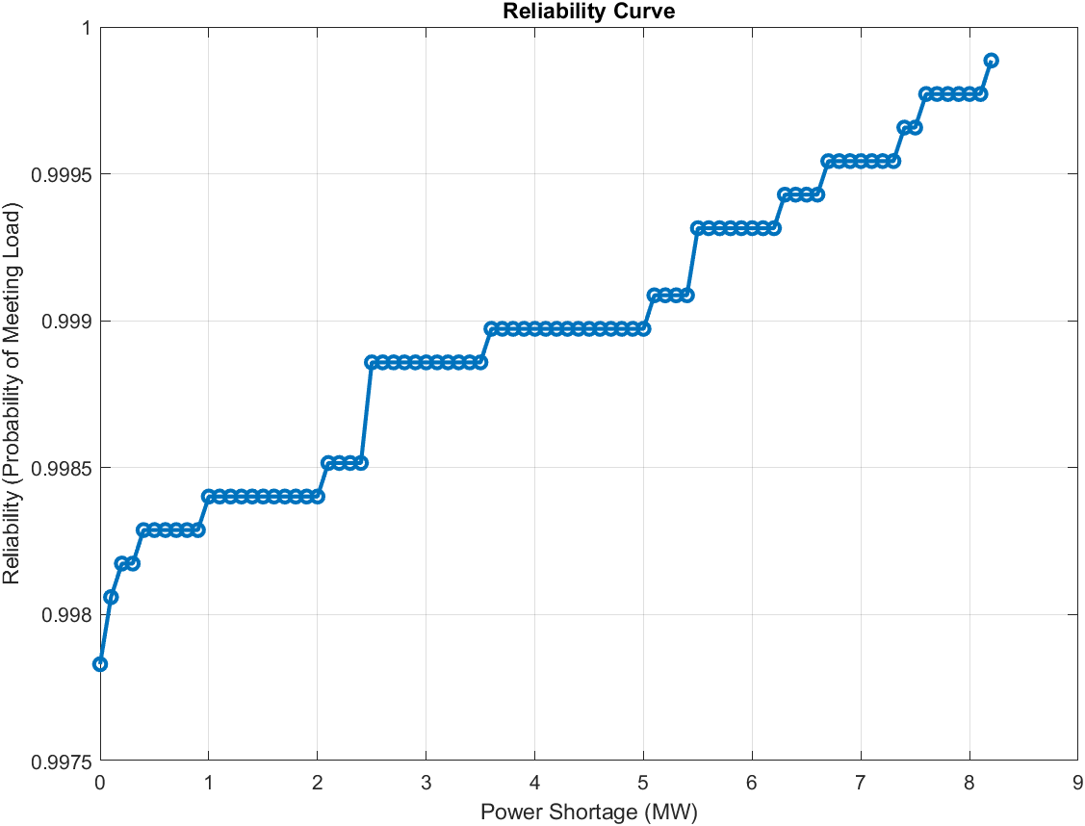
Results
32

Slide 35
Results
Energy Mix Analysis
Biomass has the largest contribution to total energy generation.
PV (Photovoltaic) contributes a smaller portion compared to Biomass and Wind.
Wind makes up the smallest segment of the total generation.
33

Slide 36
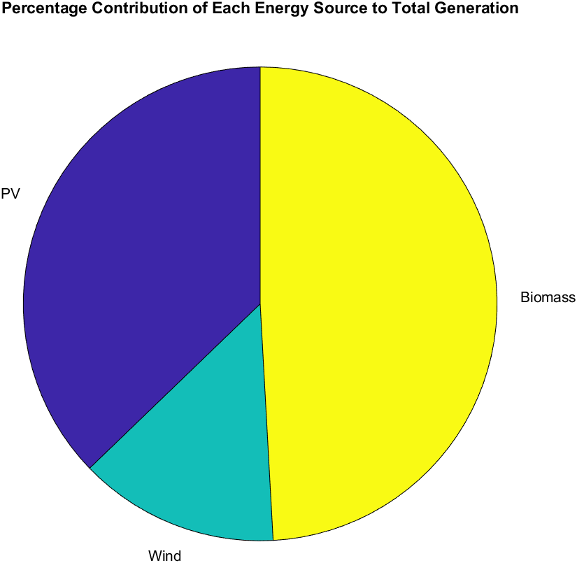
Results
34

Slide 37
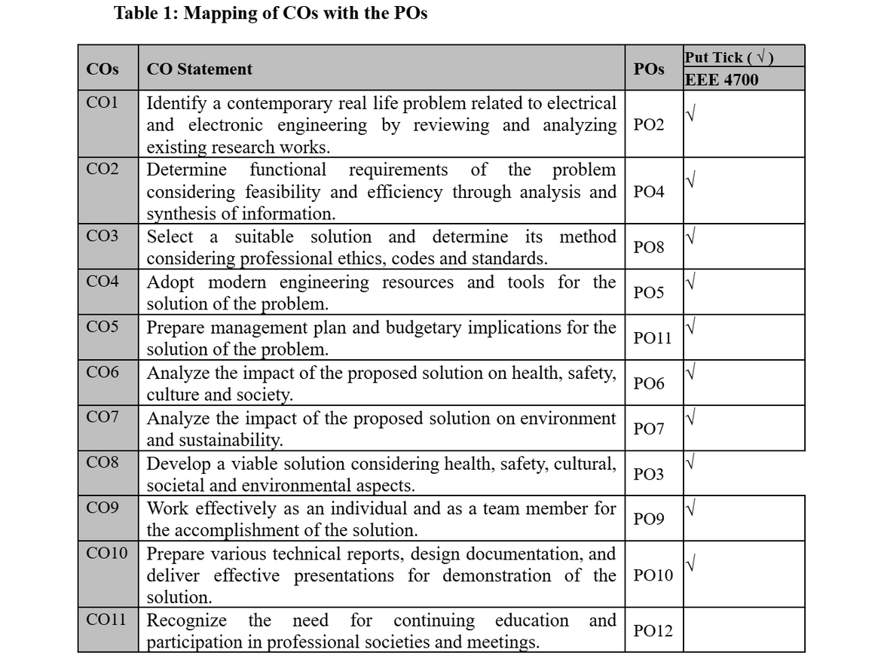
Complex Engineering Aspects
These are the course outcomes that we have achieved while working on our thesis
35

Slide 38
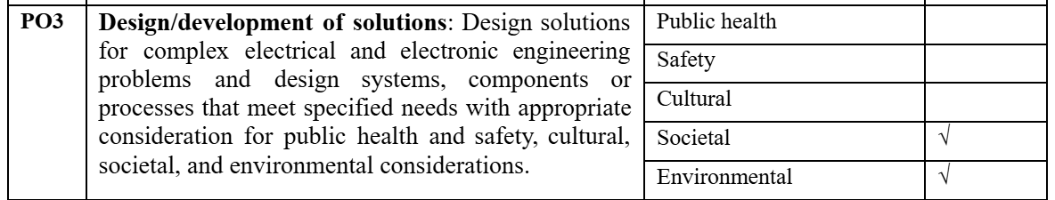
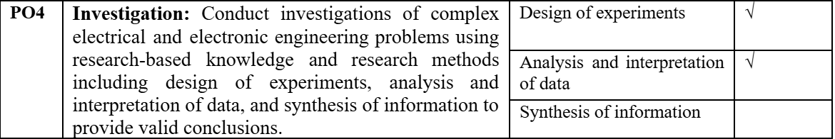
Impact Assessment
36

Slide 39
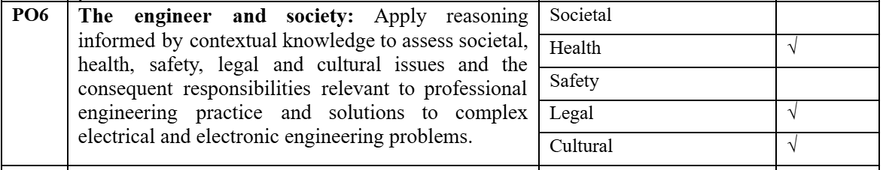
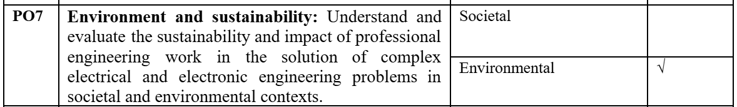
Impact Assessment
37

Slide 40
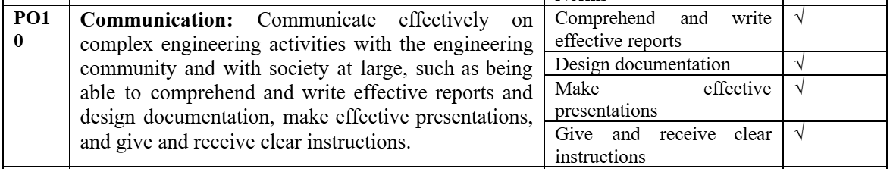
Impact Assessment
38

Slide 41

Socio-cultural, environmental, and ethical impact
Socio-Cultural
Enhances electricity access in rural/tribal areas
Empowers women & marginalized communities
Boosts education, health & local economy
39

Slide 42

Socio-cultural, environmental, and ethical impact
Environmental
Reduces CO₂ and fossil fuel dependence
Utilizes local solar, wind, biomass resources
Promotes sustainable and clean energy use
40

Slide 43

Socio-cultural, environmental, and ethical impact
Ethical
Promotes energy justice for remote populations
Supports intergenerational equity
Aligns with fair, inclusive development goals
41

Slide 44
Future Improvements
Advanced Forecasting Integration
AI driven Energy Management
Multi-Objective Optimization Objective
Grid Integration and Market Participation
42

Slide 45
References
[1] Reza, S. E., Nitol, T. A., & Abd-Al-Fattah, I. B. N. E. (2012). Present scenario of renewable energy in Bangladesh and a proposed hybrid system to minimize power crisis in remote areas. International journal of renewable energy research, 2(2), 280-288.
[2] Amiri, M. H., Mehrabi Hashjin, N., Montazeri, M., Mirjalili, S., & Khodadadi, N. (2024). Hippopotamus optimization algorithm: a novel nature-inspired optimization algorithm. Scientific Reports, 14(1), 5032.
[3] Current Status of Renewable Energy Sector in Bangladesh and a Proposed Grid Connected Hybrid Renewable Energy System
[4] Halder, P. K., Paul, N., Joardder, M. U., & Sarker, M. (2015). Energy scarcity and potential of renewable energy in Bangladesh. Renewable and Sustainable Energy Reviews, 51, 1636-1649.
[5] http://www.bpdb.gov.bd/
[6] https://en.wikipedia.org/wiki/Electricity_sector_in_Bangladesh
[7] Hossain, M. A. (2019). Size Optimization of Hybrid Renewable Energy System using Meta-Heuristic Algorithm (Doctoral dissertation, Department of Electrical and Electronic Engineering, Islamic University of Technology, Board Bazar, Gazipur, Bangladesh).
[8] https://energytracker.asia/the-electricity-sector-in-bangladesh-what-comes-next/
43

Slide 46
[9] SREDA (Sustainable & Renewable Energy Development Authority). (n.d.). Projects / Programs. Retrieved September 28, 2025, from https://ndre.sreda.gov.bd/index.php?id=7
[10] Alam, S. (2024, August 29). How to make Bangladesh’s power sector sustainable. Institute for Energy Economics and Financial Analysis (IEEFA). https://ieefa.org/resources/how-make-bangladeshs-power-sector-sustainable
44

Slide 47


